Slide 1
Group 6
Joel Brandom, Jacob Brandom, Min Xiong, Kris Berkland, Hamza Chaudhry, Adrian Williams

Slide 2
Style is not currently finalized, though is being thought out.
Button locations are good. (Most functions will stay in navbar)
Plan to change colors, hopefully take it away from the “default” look.

Slide 3
You can login and if who logs in is an admin gets extra privileges.
Things like editing and deleting tv shows and services.
You can add Services and prices.
Anonymous users have access to the least amount of things.

Slide 4
Still much work to be done
Network functionality, Report functionality, viewing statistics, and more.
(Among front end details already mentioned).

Slide 5
You can login and if who logs in is an admin gets extra privileges.
Things like editing and deleting tv shows and services.
Anonymous users have access to the least amount of things.
Report function still in development.

Slide 6
DATABASE

Slide 7
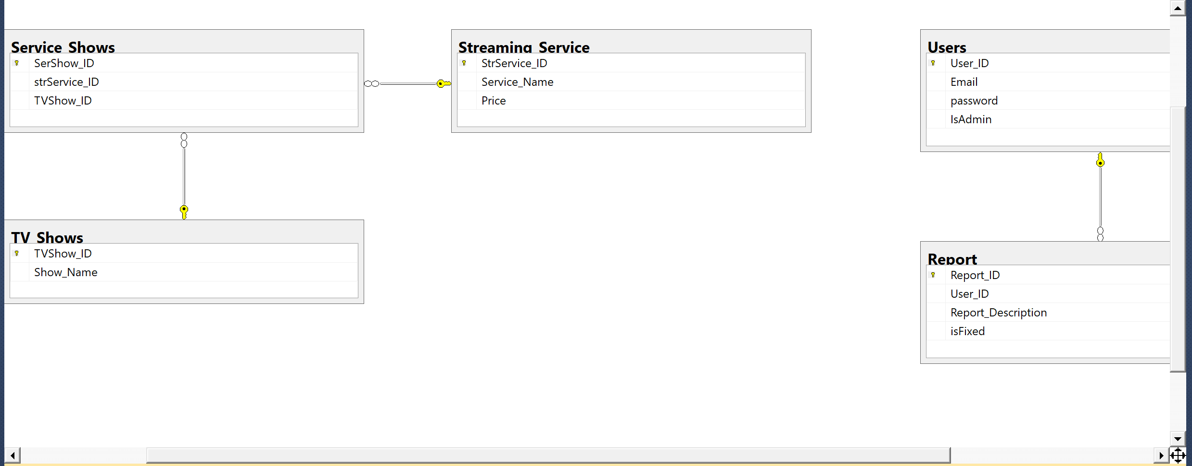

Slide 8
Create database TV_service
use TV_service
create table Users(
User_ID int not null
identity(1,1),
Email nchar(50) not null,
password int null,
IsAdmin bit null,
constraint UsersPK PRIMARY KEY (User_ID)
);
create table Streaming_Service(
StrService_ID int not null
identity(1,1),
Service_Name varchar(50) not null,
Price float null,
constraint Streaming_ServicePK PRIMARY KEY (StrService_ID)
);

Slide 9
create table TV_Shows(
TVShow_ID int not null
identity(1,1),
Show_Name varchar(50) not null,
constraint TV_ShowsPK PRIMARY KEY(TVShow_ID)
);
create table Service_Shows(
SerShow_ID int not null
identity(1,1),
strService_ID int not null,
TVShow_ID int not null,
constraint Service_ShowsPK PRIMARY KEY(SerShow_ID),
constraint Service_Shows_Streaming_ServiceFK FOREIGN KEY (StrService_ID)
REFERENCES Streaming_Service (StrService_ID),
constraint Service_Shows_TV_ShowsFK FOREIGN KEY (TVShow_ID)
REFERENCES TV_Shows (TVShow_ID)
);
create table Report(
Report_ID int not null
identity(1,1),
User_ID int not null,
Report_Description varchar(300) null,
isFixed bit null,
constraint ReportPK PRIMARY KEY(Report_ID),
constraint Report_UsersFK FOREIGN KEY (User_ID)
REFERENCES Users (User_ID)
);

Slide 10
insert into Users(Email, password, IsAdmin) VALUES ('jabl@MAIL.UMKC.EDU',20131009,0)
SELECT* FROM Users
insert into TV_Shows(Show_Name) VALUES ('Sling')
SELECT* FROM TV_Shows
insert into Streaming_Service(Service_Name, Price) VALUES ('youtube',22.5)
SELECT* FROM Streaming_Service
insert into Report(User_ID, Report_Description, isFixed) VALUES (2, 'still cannot work well', 0)
SELECT* FROM Report
insert into Service_Shows(strService_ID, TVShow_ID) values (6,6)
SELECT* FROM Service_Shows

Slide 11
SELECT * FROM Users;
update Users set Email = 'mxiong6886@gmail.com'where User_ID = 2;
delete from Users where User_ID = 9 ;
select *from TV_Shows;
UPDATE TV_Shows set Show_Name = 'The Get Down' where TVShow_ID = 6;
select * from Streaming_Service;
delete from Streaming_Service where StrService_ID = 9;
select * from Streaming_Service;
select *from Service_Shows;
select *from Report;

Slide 12
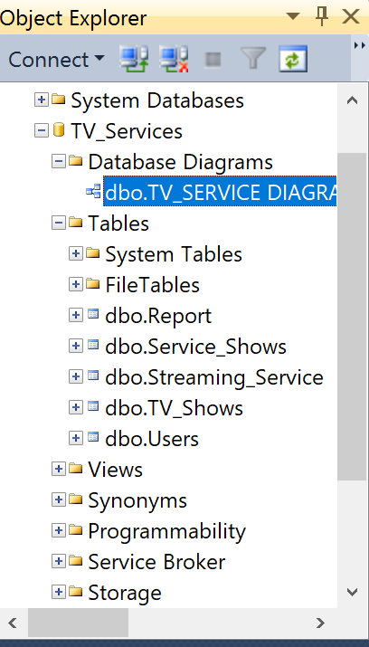

Slide 13
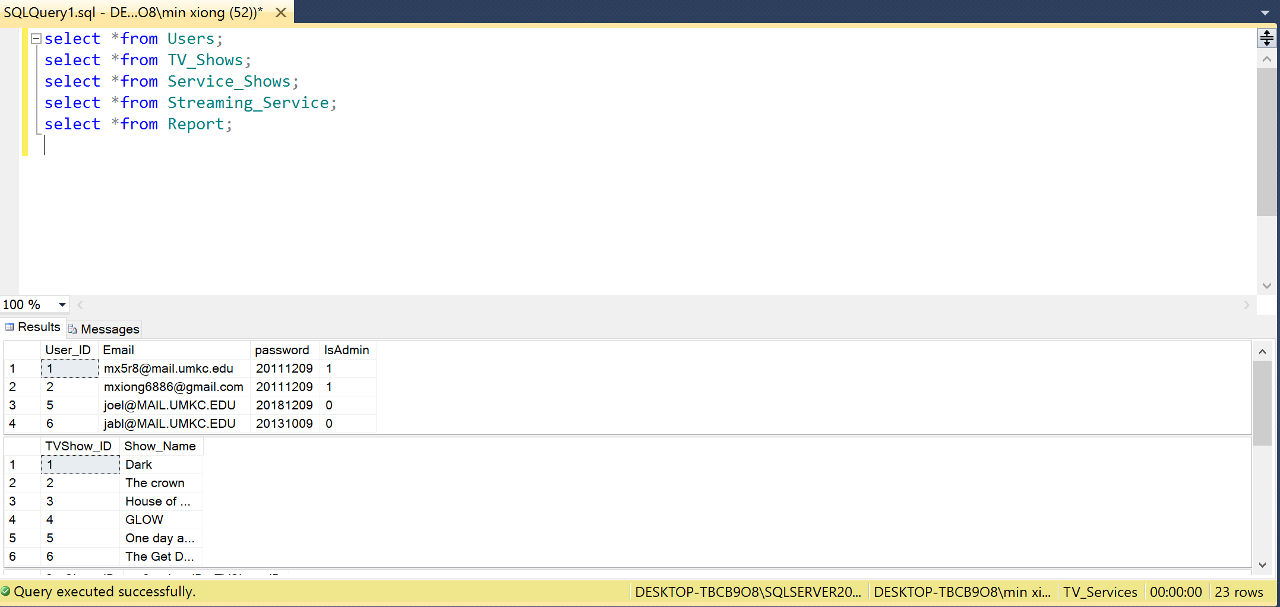

Slide 14
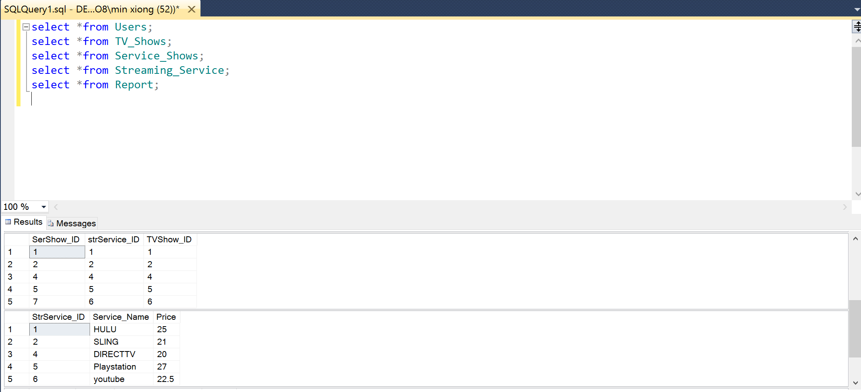

Slide 15
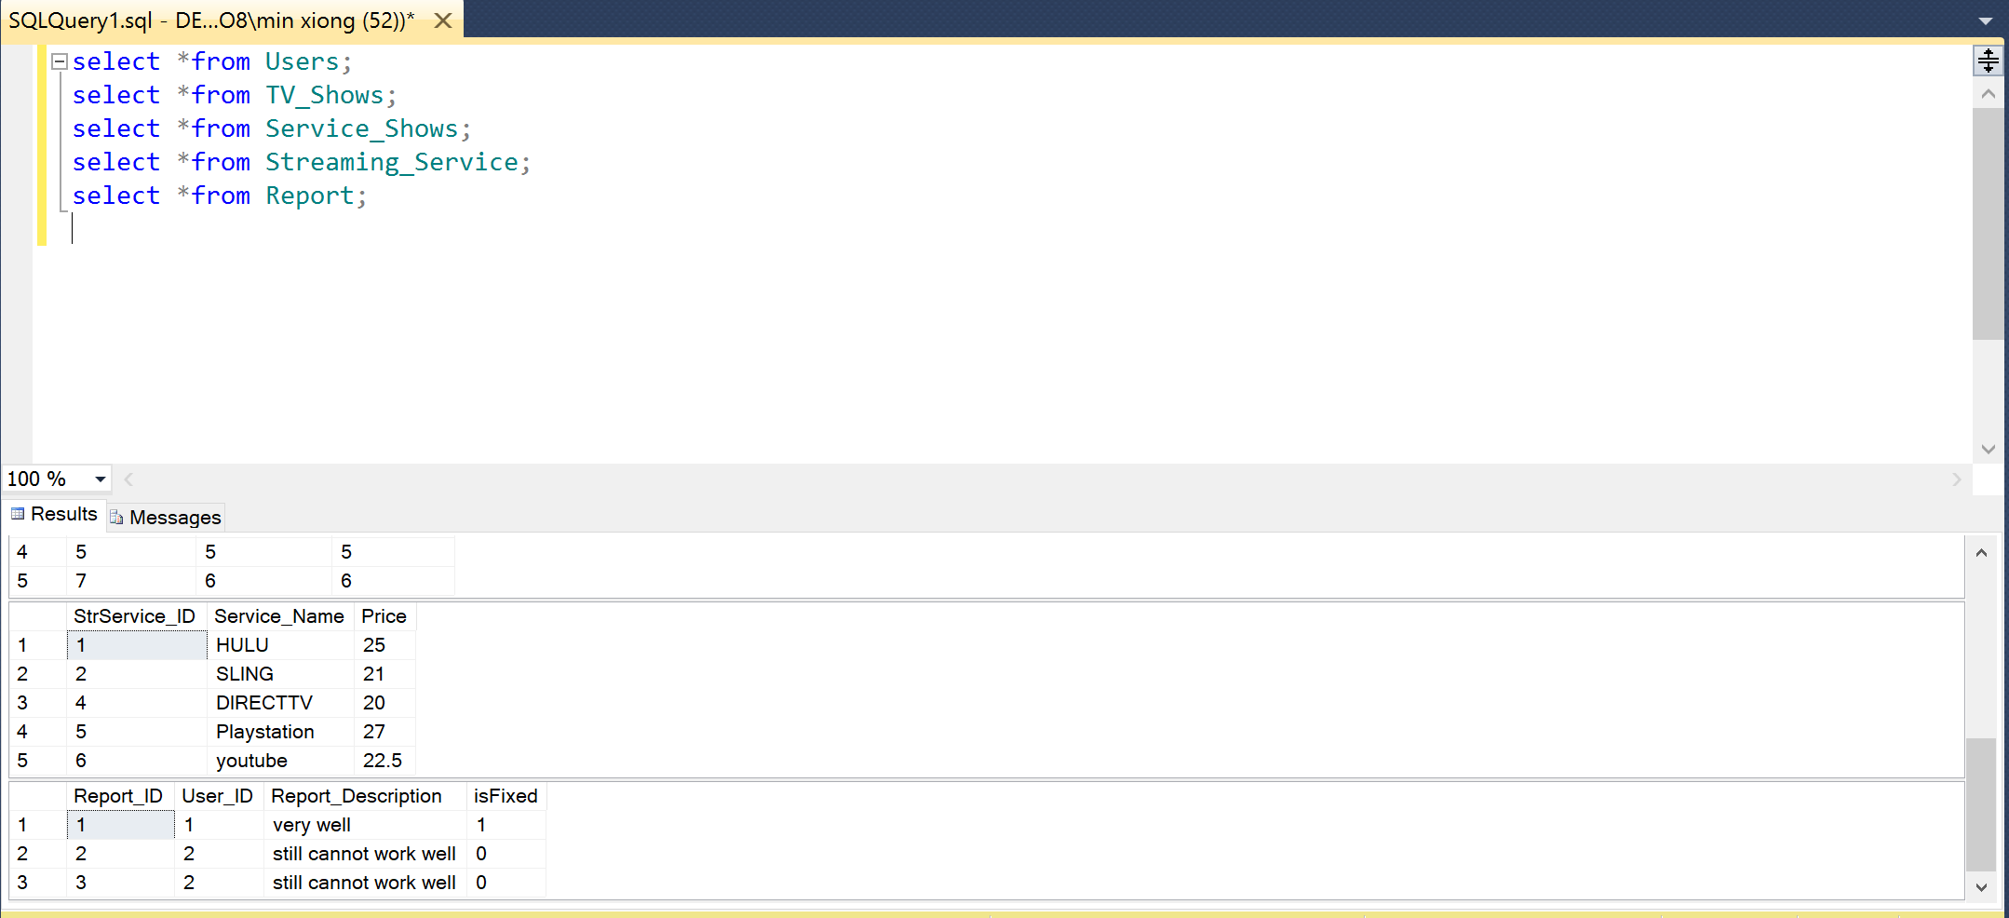

Slide 16
Next step:
Use SSMS to connect to AZURE SQL database!
https://docs.microsoft.com/en-us/azure/sql-database/sql-database-connect-query-ssms

